Slide 1
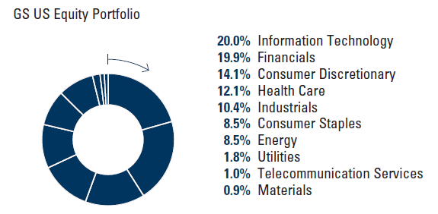
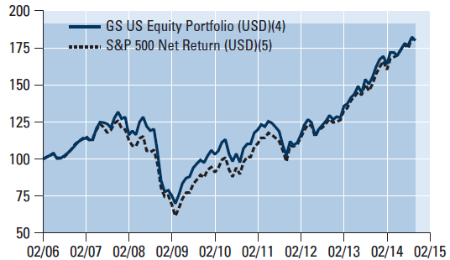
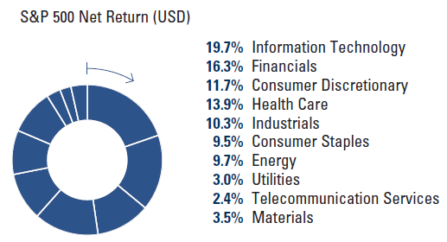
0914
Goldman Sachs US Equity Portfolio
Overall Morningstar Rating™^{[1]} «««
A sub-fund of Goldman Sachs Funds, SICAV
Investment Objective
The Portfolio seeks to provide capital growth over the longer term. For full investment objective and policy details see the Prospectus.
Performance (%)‏
Performance Summary (%)‏
 | 30-Sep-09 - 30-Sep-10 | 30-Sep-10 - 30-Sep-11 | 30-Sep-11 - 30-Sep-12 | 30-Sep-12 - 30-Sep-13 | 30-Sep-13 - 30-Sep-14
Fund (USD) | 7.9 | -4.5 | 26.6 | 19.9 | 16.0
Index | 9.5 | 0.5 | 29.3 | 18.5 | 19.0
 |  |  | Cumulative |  |  | Annualised
 | Since Launch | 1 Mth | 3 Mths | YTD | 1 Yr | 3 Yrs | 5 Yrs
Base Shares Distribution⁽⁴⁾ | 80.00 | (1.26) | 1.24 | 6.32 | 15.98 | 20.74 | 12.65
S&P 500 Net Return (USD) ⁽⁵⁾ | 76.59 | (1.45) | 0.97 | 7.85 | 19.00 | 22.17 | 14.96
US Large-Cap Blend Equity Sector av. ⁽⁶⁾ | 68.43 | (1.84) | (0.02) | 6.20 | 16.37 | 19.97 | 12.73
Quartile Position in Sector ⁽⁶⁾ | 1 | 3 | 3 | 4 | 4 | 3 | 3
OCS (Acc.) (EUR-Hdgd)⁽⁴⁾ | 100.00 | (1.28) | 1.27 | 6.38 | 15.94 | 20.10 | 12.07
S&P 500 (NTR, 100% Hgd to EUR) ⁽⁵⁾ | 124.04 | (1.53) | 0.90 | 7.63 | 18.68 | 21.37 | 13.99
Base Shares (Acc.)⁽⁴⁾ | 79.70 | (1.26) | 1.24 | 6.33 | 16.01 | 20.76 | 12.66
Fund Data
Industry Allocation (%)‏
No. of holdings
63
% in top 10
29
Turnover ratio (%)‏
52
Financial Information^{(2)‏}
Performance (Indexed)‏
Historical Volatility Portfolio - 3 yrs
11.11
R ²- 3 yrs
0.92
Net Asset Value (NAV ) – Base Shares Distribution^{(3)‏}
18.00
Beta - 3 yrs
USD
1.02
Net Asset Value (NAV) – OCS (Acc.)(EUR-Hdgd)^{(3)‏}
20.00
Excess returns - 3 yrs
EUR
-1.43
Net Asset Value (NAV) – Base Shares (Acc.)^{(3)‏}
USD
Historical Tracking error - 3 yrs
17.97
3.20
Total Net Assets (m)‏
3,016
Fund Facts
USD
ISIN - Base Shares Distribution
LU0234587219
Fund Characteristics
ISIN - OCS (Acc.) (EUR-Hdgd)‏
LU0433926036
Currency - Base Shares Distribution
USD
ISIN - Base Shares (Acc.)‏
LU0234588027
Currency - OCS (Acc.) (EUR-Hdgd)‏
EUR
Bloomberg Ticker - Base Shares Distribution
GSUSBBA
Currency - Base Shares (Acc.)‏
USD
Bloomberg Ticker - Base Shares (Acc.)‏
GSUBEBA
Inception Date - Base Shares Distribution
03-Feb-06
Dealing and valuation
Daily
Inception Date - OCS (Acc.) (EUR-Hdgd)‏
17-Jun-09
Reporting year end
30 November
Inception Date - Base Shares (Acc.)‏
03-Feb-06
This is an actively managed fund that is not designed to track its reference benchmark. Therefore the performance of the fund and the performance of its reference benchmark may diverge. In addition stated reference benchmark returns do not reflect any management or other charges to the fund, whereas stated returns of the fund do.
Reference Benchmark
S&P 500 Net Return (USD)‏
GSAM Int., US Equity Team
Fund Domicile
Luxembourg
Fund manager
Settlement
T + 3
EU Savings Directive
Not In Scope
Top 10 Holdings^{(8)‏}
Fund Company
Goldman Sachs Funds, SICAV
Initial Sales Charge - up-to (%)‏
5.5
Security | % | Country | Activity
General Electric Co. | 3.9 | United States | Capital Goods
Apple Inc. | 3.5 | United States | Technology Hardware & Equipment
Bank of America Corp. | 3.3 | United States | Diversified Financials
Microsoft Corp. | 3.0 | United States | Software & Services
JPMorgan Chase & Co. | 2.8 | United States | Diversified Financials
Boeing Company, The | 2.7 | United States | Capital Goods
Google Inc. | 2.7 | United States | Software & Services
Devon Energy Corp. | 2.5 | United States | Energy
Nike, Inc. | 2.5 | United States | Consumer Durables & Apparel
Exxon Mobil Corp. | 2.2 | United States | Energy
Management Fee (%)‏
1.50
Performance Fee (%)‏
0.00
Total Expense Ratio (%)⁽⁷⁾‏
1.90
Please see Additional Notes. All performance and holdings data as at 30-September-14.
⁽¹⁾ More information about the Overall Morningstar Rating and its calculation can be found on the following website: www.morningstar.com. ⁽²⁾ Please note that the Goldman Sachs US Equity Portfolio currently operates with income equalisation. The current income equalisation figures for the Goldman Sachs US Equity Portfolio are available on request from our Shareholder Services team on +44 20 7774 6366 (email: ess@gs.com). Investors may want to discuss with their tax adviser the impact, if any, of income equalisation on them. ⁽³⁾ The Net Asset Value represents the net assets of the Portfolio (ex-dividend) divided by the total number of shares. ⁽⁴⁾ Portfolio returns are shown net of applicable ongoing fees within the portfolio, with dividends re-invested using the ex-dividend NAV. These returns are for comparison of performance against specified index. As the investor may be liable to other fees, charges and taxes, they are not meant to provide a measure of actual return to investors. The performance data do not take account of the commissions and costs incurred on the issue and redemption of shares. ⁽⁵⁾ The S&P 500 Net Return Index, is quoted at month-end with income reinvested and, in contrast to the Portfolio, shown without the deduction of any expenses. ⁽⁶⁾ As of Mar-09 Morningstar has changed the category of this fund from US Large Cap Blend to US Large Cap Growth. Following the Morningstar categorization, the Monthly Fund Updates for this fund up to and including March 2009 have compared the fund's performance against the US Large Cap Blend universe. Following Morningstar's recategorization, the Monthly Fund Update for April 2009 compared the performance of the fund against the US Large Cap Growth universe. From May 2009 on, the Monthly Fund Update will revert to comparing the fund's performance against the U.S. Large Cap Blend universe whereas Morningstar continues to categorize this fund as US Large Cap Growth. The Morningstar sector average figures are calculated using all open funds available in the universe at
the indicated time period. The number of funds in a Morningstar sector varies over time as new funds are launched and funds close. Therefore the number of funds in a Morningstar sector at a portfolios launch may be less, or may be more, over shorter time periods. Source: Morningstar. © 2014 Morningstar, Inc. All Rights Reserved. The information contained herein: (1) is proprietary to Morningstar and/or its content providers; (2) may not be copied or distributed; and (3) is not warranted to be accurate, complete or timely. Neither Morningstar nor its content providers are responsible for any damages or losses arising from any use of this information. Past performance is no guarantee of future results. ⁽⁷⁾ Included in the calculation of the Total Expense Ratio (TER) are the fees of the Investment Adviser, the Distributor and certain ongoing expenses as described in further detail in the KIID. Dealing commissions and market costs will, however, not be included in the calculation of the TER. The TER of the “B” Shares will also include a Contingent Deferred Sales Charge (CDSC) as described in the Prospectus. ⁽⁸⁾ Portfolio holdings may not represent current, future investments or all of the portfolio's holdings. Future portfolio holdings may not be profitable.
For RHBIM’s Use Only and Not For Distribution To The General Public.
Please note that Goldman Sachs Asset Management does not maintain any licenses, authorizations or registrations in Asia ex Japan, except that it conducts businesses (subject to applicable local regulations) in and from the following jurisdictions: Hong Kong, Singapore, Malaysia, Korea, and India
Goldman Sachs (Malaysia) Sdn Bhd is licensed in Malaysia to undertake the regulated activity of fund management. Goldman Sachs has no GSAM funds registered in Malaysia and securities may not be offered or sold in Malaysia unless it comes within the ambit of its licensed activities in Malaysia.

Slide 2
声明：
所有的版权属于原有公司，文件均来自公开渠道
此文件仅供学习使用，任何人不得进行以此为商业目的的行为
如有疑问，请立即删除
学习世界五百强和咨询公司PPT课程请访问如下网站搜索：“司马懿”
百度传课：司马懿PPT学校
https://www.chuanke.com
网易学堂：司马懿PPT学校
https://study.163.com
知乎： 司马懿PPT学校
https://www.zhiu.com

